Slide 1

Gwinnett County Public Schools Real-Time Bus Monitoring 12-T3-Gwinnett-Bus

Slide 2
Our Team
Sam Bostian
Team Leader
Michael Rizig
Kafka, Python Dev, MSSQL
Charlie McLarty
Data Generation
Brian Pruitt
Documentation
Allen Roman
Containerization
General Help
Deployment
Data Simulation
Primary Development
RHEL9 Install

Slide 3

Sponsor
Gwinnett County Public Schools (GCPS) is the largest school system in Georgia and the 14th largest school district in the US.
Approximately 182,000 students attend one of GCPS’s 182 Schools with a fleet of almost 2,000 buses.
School Breakdown:
81 Elementary Schools
29 Middle Schools
24 High Schools
7 Specialty Schools
1 Charter School
Notes:
Gwinnett County Public Schools Division of Innovation and technology
Client -> GCPS Department of transportation and Fleet Maintence

Slide 4

Problem Statement
Currently GCPS uses Samsara REST API calls to poll for bus data approximately every 5 seconds.
Due to the vast bus fleet and how many calls made per minute GCPS makes, they are currently in the top 1% of all of Samsara’s API calls.
GCPS would like to switch to using the Samsara Connector and store this bus data into an SQL relational database that can be called by other applications for near real-time data processing.
Notes:
Because of over 8000 runs per day

Slide 5

Project Overview
Objective:
Transition from Samsara API polling to Kafka-based event streaming for real-time bus tracking, creating an in-house solution for efficiency and data security.
Efficiently process and validate bus telemetry data and store it in SQL Server.

Slide 6
Planning

Slide 7
Planning
Testing
Agile Parallel Development
Divided work into parallel development streams
Meeting Cadence
Industry Sponsor Meetings
Team meetings
Tools and Collaboration
Version Control
Communication Platforms
Deployment
Development
Review
Design
Requirements
Notes:
Agile Parallel Development
Adopted Agile methodology to stay flexible and adapt to evolving milestones and requirements.
Divided work into parallel development streams, with tasks assigned based on each member's expertise.
Meeting Cadence
Industry Sponsor Meetings:
Weekly check-ins every Monday, 4:45-5:45 PM with GCPS representatives to align on progress and expectations.
Addressed changing requirements and ensured alignment with sponsor goals.
Internal Team Meetings:
Regular internal meetings on Microsoft Teams and Discord to coordinate efforts.
Frequent touchpoints allowed the team to track progress and resolve blockers promptly.
Tools and Collaboration
Version Control: GitHub repository for code management and task tracking.
Communication Platforms: Discord for internal team communication; Microsoft Teams for sponsor collaboration.

Slide 8
Key System Components
Kafka Broker
Publisher-Subscriber Paradigm
Bus Simulation
Generates synthetic bus data and streams it to Kafka.
MSSQL Database
Stores validated data; logs anomalies in a separate table.
Data Manager
Handles data validation and manages SQL operations.
Containerization
Ensures consistent deployment across environments.
RHEL9 Server
Integrates Kafka, MSSQL, and all other components into one seamless application.

Slide 9
Development

Slide 10
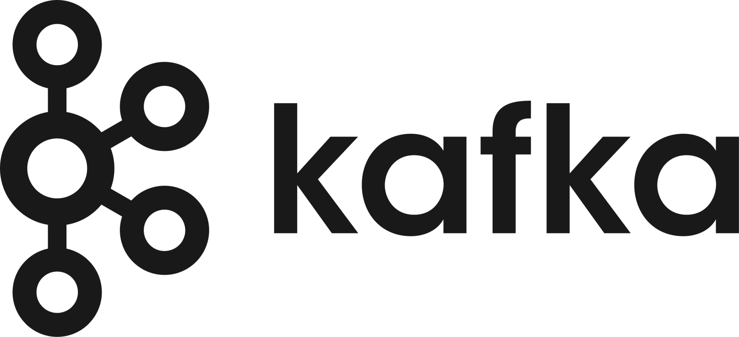



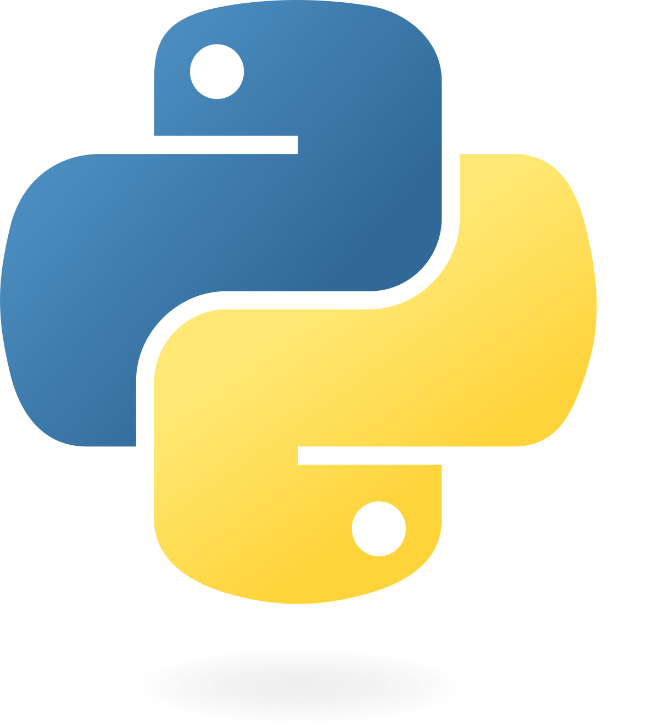

Tech Stack

Slide 11
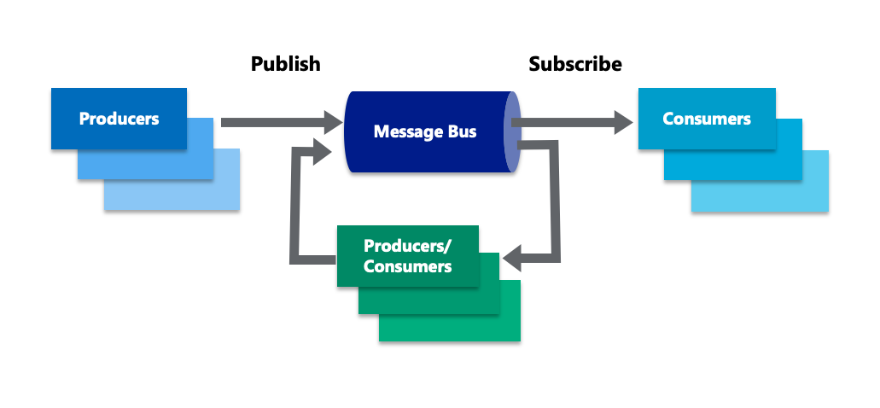
Kafka Basics
Apache Kafka can be generally described as an implementation of the Publisher Subscriber Paradigm.
Publishers (Producers) send data to the broker (Kafka Server), which distributes the data to all Subscribers (Consumers) of that topic.
Ex. Live Streaming

Slide 12
Server process overview

Slide 13
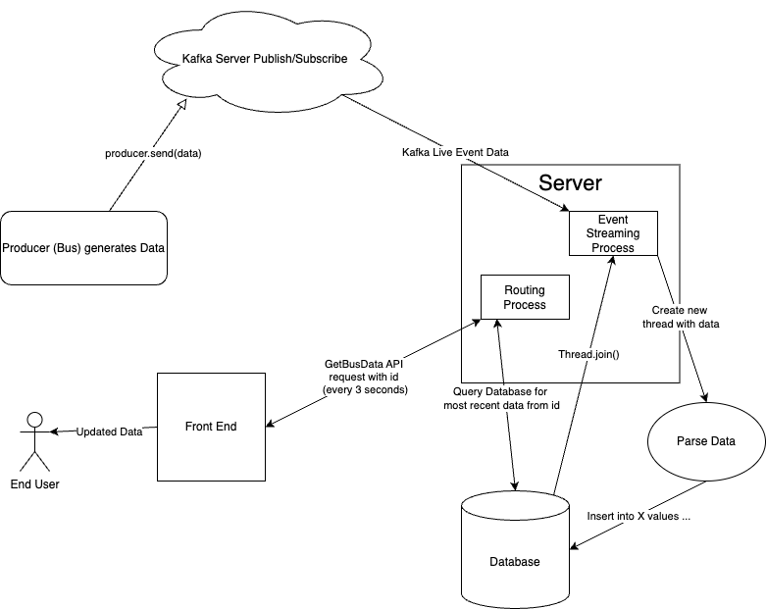
Dataflow

Slide 14
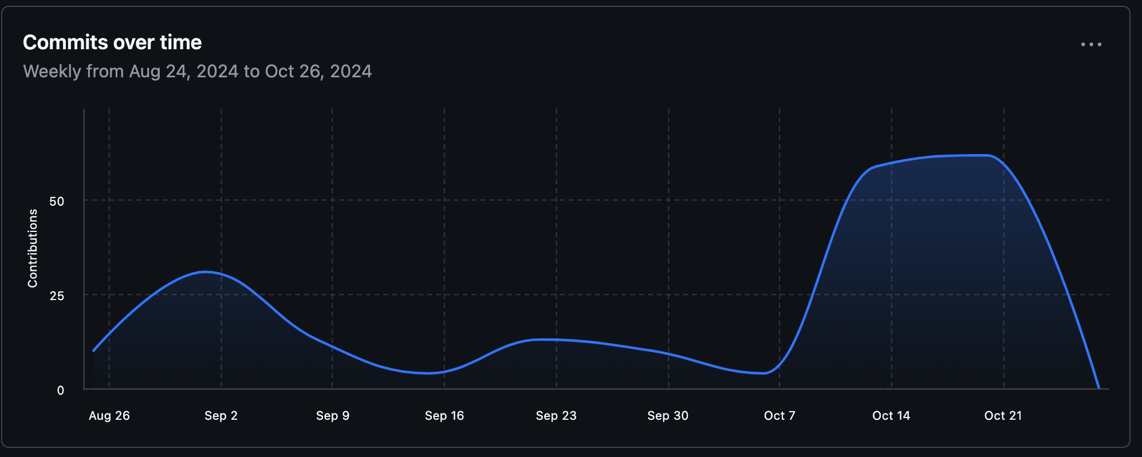
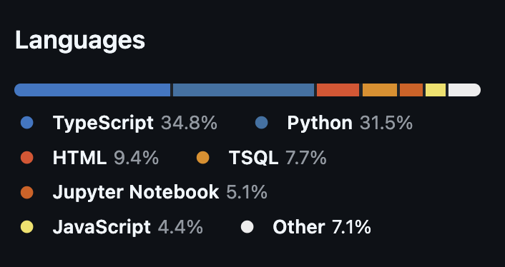
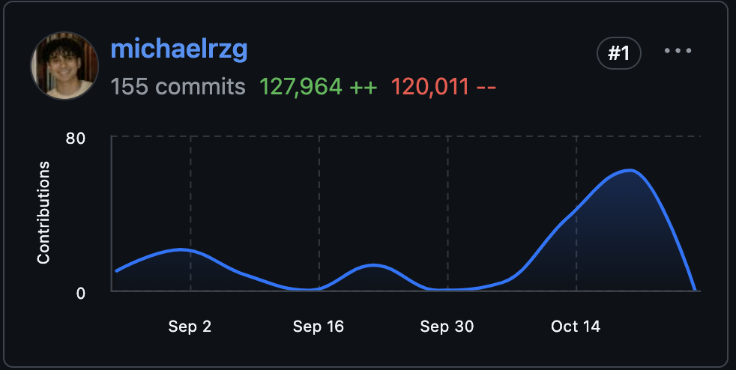
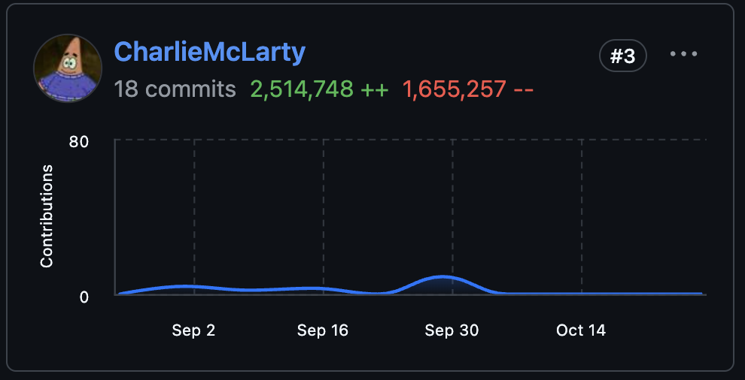
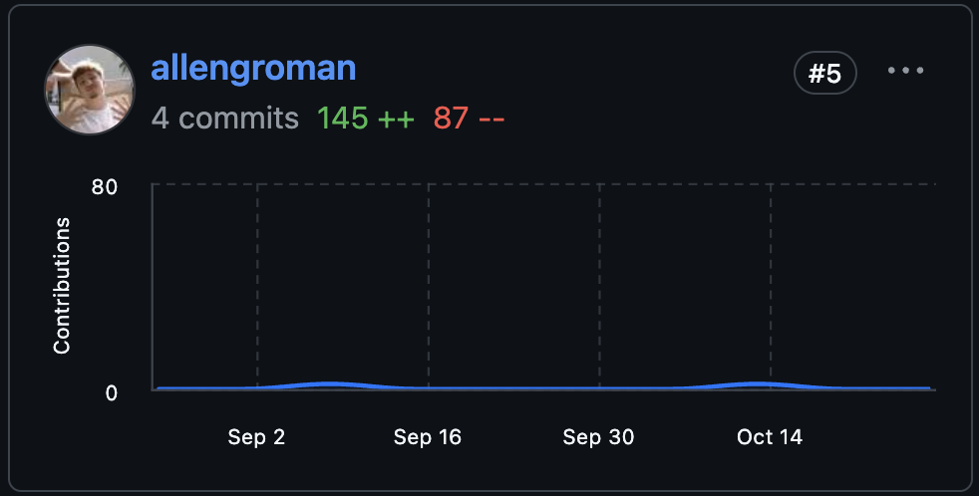
Execution
Language Breakdown
Python Dev, MSSQL, Kafka
Data Generation / Simulation
Containerization

Slide 15
Testing and Quality Assurance

Slide 16
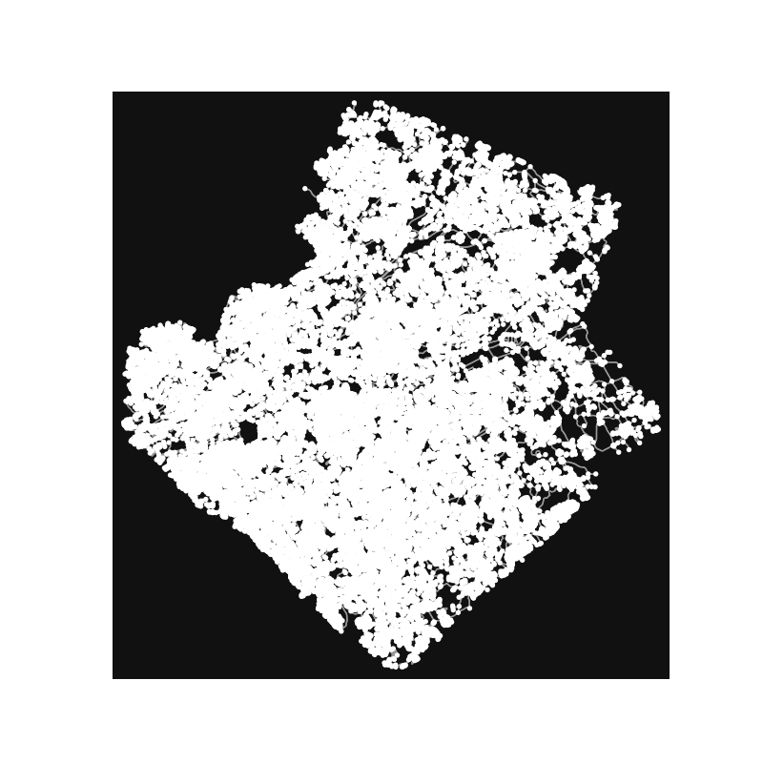
Synthetic Data Generation
Gwinnett County map converted to directed graph
Bus calculates distance traveled from speed (m/s) * 5 second's along current edge of graph
Data collector receives updates from each bus and streams to the Kafka producer
In Progress:
Better bus route logic (starts from school and eventually returns)
Generating geofences for each school
Realistic time simulation of each bus traveling in morning before school to track whether a bus is running on time
Gwinnett county represented as a strongly connected graph

Slide 17
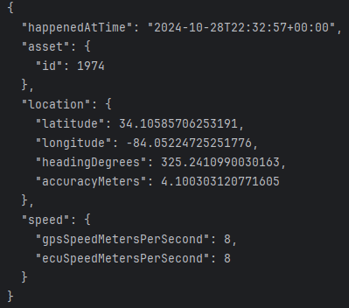
Scaling and Quality Assurance
Bus location and direction needs to be calculated every 5 seconds to simulate real-life scenario
GCPS contains >1500 active buses at peak times
Object Serialization for graph, node locations, and edge direction/lengths
Bus location update and data collection tasks run asynchronously

Slide 18
Deployment

Slide 19
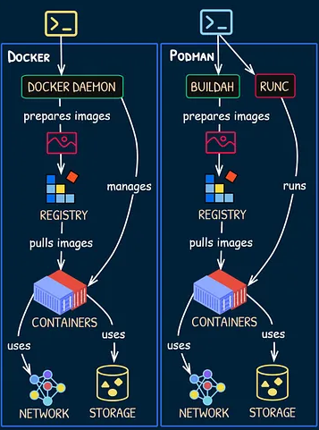
Containerization
Containers provide isolated environment for applications
They offer reliable and consistent testing and deployment across different machines
Podman is a daemon-less alternative to Docker for containerization
Pods deploy groups of containers together and share resources
Application runs a Pod with a container for the producer-side and one for the consumer-side

Slide 20
But wait, there’s more!

Slide 21

Front-End Live Bus Tracker (Phase 2)
(Optional) Implement a Front-End live bus tracking application
When proposing this idea, GCPS mentioned an optional extension to the project to include a front-end app to monitor bus locations on a macro scale.
While this was optional, we took on the challenge

Slide 22
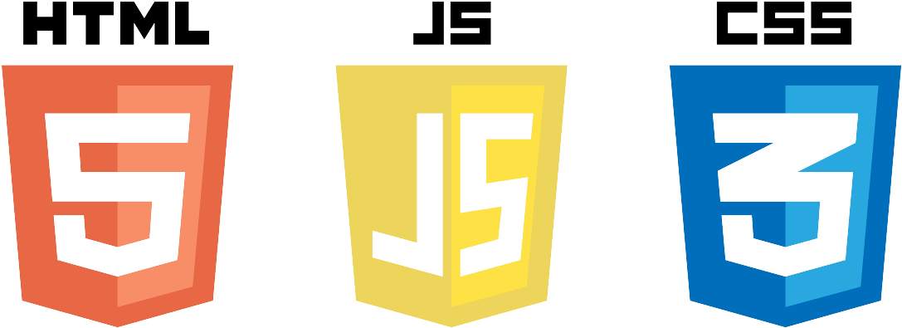
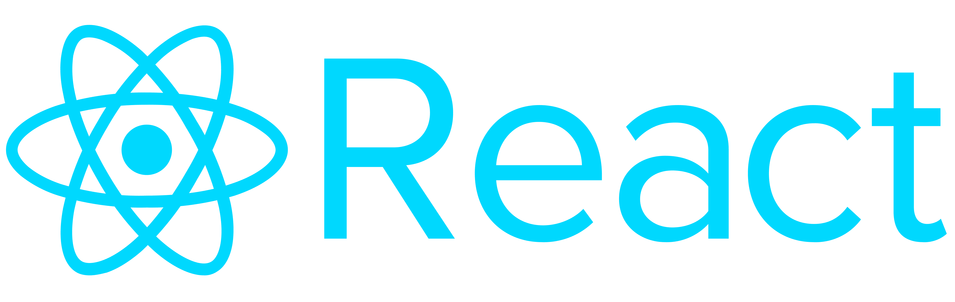


Tech Stack (Front End)

Slide 23


Demo

Slide 24
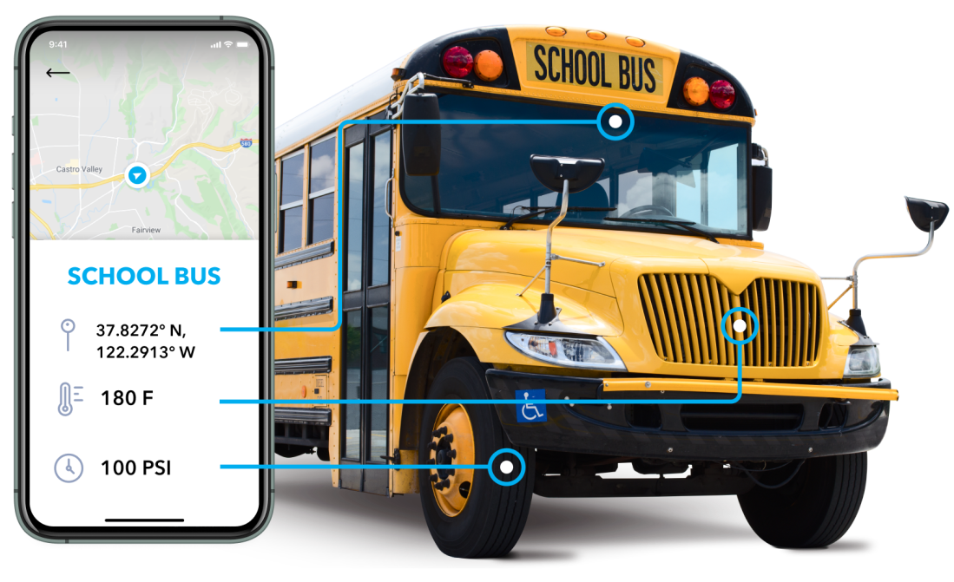
Phase 3: Connection Monitoring and More…
Implement a second application that monitors system status, health, and data connection for IT administration.
Create multiple roles to allow for different views for users.
Enhance the frontend icons to allow schools to know which buses are running late.

Slide 25
Challenges
Changing Milestones and Requirements
This was the sponsor's first time collaborating with a senior project class, let alone 3!
Milestones and requirements evolved throughout the project, requiring the team to stay adaptable and proactive.
Frequent adjustments affected planning and resource allocation, making it necessary to revise deliverables on the go.
Technical Learning Curve
Team members had to quickly familiarize themselves with Kafka, containerization (Podman), and MS SQL Server integration on Linux.
The multi-threaded environment introduced complexity, particularly in managing real-time event streams efficiently.
Simulating Real-World Data Loads
Creating realistic simulations to mimic 2,000 buses streaming data in real-time was a challenge.
Testing the system for error handling and performance bottlenecks under synthetic load required iterative development.
Communication Across Platforms
Managing effective communication through Discord, Microsoft Teams, and GitHub was crucial but challenging.
Ensuring that the entire team stayed aligned on changing requirements and timelines required frequent meetings and status updates.

Slide 26

Questions?

